Slide 1

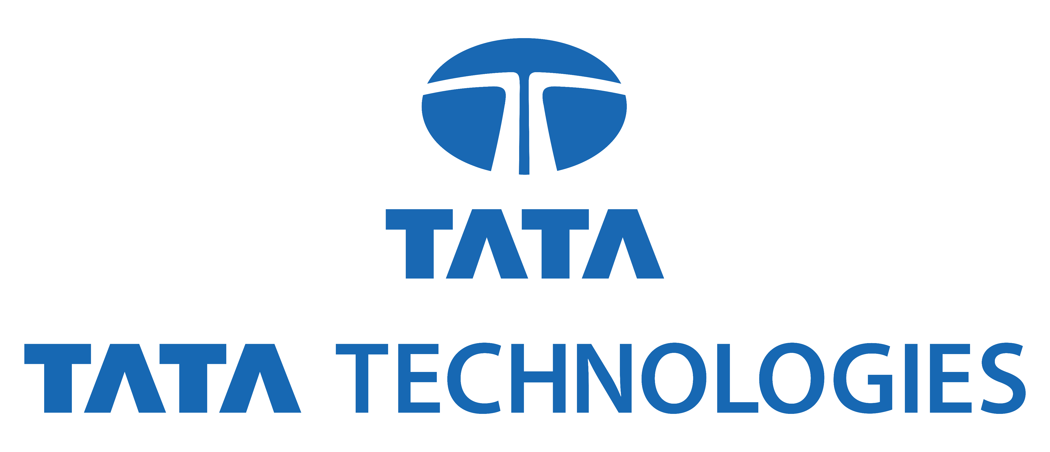
TATA TECHNOLOGIES INNOVENT InnoVent solutions for a better world​
TEAM NAME:
S3RK
TEAM MEMBERS:
1.Sowmithaa Sri S
2.NVS Keerthana Lingamallu
3. Rithikha R
4. Sannidhay Jangam
5.Shwetha M

Slide 2





Innovent Team S3RK
Shwetha Mahesh
Model Deployment
S Sowmithaa Sri
Team Lead
N.V.S Keerthana
Model Visualizations
Rithikha R
Dataset Operations
Sannidhay Jangam
Model Training

Slide 3
PROJECT TITLE: Real-time AI Based Defect Detection for Automotives during production
PROBLEM STATEMENT:
An AI tool that uses image recognition algorithms to detect defects in real time during vehicle production.
In the automotive industry, maintaining high-quality standards during production is critical. Detecting defects in real-time as vehicles are manufactured can significantly reduce costs, improve safety, and ensure customer satisfaction. However, traditional inspection methods are time-consuming and prone to human error. The challenge is to develop an AI-based solution that can accurately and efficiently detect defects in real-time during the production process. This project aims to leverage advanced image recognition algorithms and machine learning models to identify defects in automotive parts, ensuring quality control and reducing the need for post-production inspections.
The project focuses on developing a deep learning model for detecting and classifying car parts in images. The goal is to create an accurate and efficient system for automated vehicle inspections, inventory management, and quality control. The challenge is to develop a model that can accurately identify and localize various car parts in images, considering factors like occlusion, varying lighting conditions, and different part orientations.

Slide 4
project’s main OBJECTIVE ?
Objective: Our primary objective is to revolutionize quality assurance in automotive manufacturing by implementing an advanced AI-driven defect detection system. This system aims to minimize defects, reduce costs associated with rework and recalls, and ensure that every vehicle component meets the highest standards of quality.
"Drive the Future of Quality with Tata Technologies " By integrating our state-of-the-art AI-driven defect detection system, Tata Technologies is pioneering a new era of quality assurance in the automotive industry. Our groundbreaking technology not only revolutionizes the manufacturing process within Tata Technologies, ensuring every vehicle component exceeds industry standards, but also positions us as a leader in innovation. This commitment to excellence translates to unparalleled reliability, precision, and efficiency, significantly reducing costs associated with rework and recalls.
Additionally, our AI-driven system enhances product consistency and customer satisfaction, establishing a new benchmark for quality. By offering this advanced technology to the market, Tata Technologies is poised to transform the industry, providing other manufacturers with the tools to achieve similar success. Experience the future of automotive manufacturing with Tata Technologies, where cutting-edge technology and superior quality converge to drive excellence and innovation across the industry.

Slide 5
describe the
approach
2. Precision Detection:
Utilizing Detectron2’s powerful Mask R-CNN architecture, configured with optimal hyperparameters from the model zoo, ensures superior defect detection accuracy.
3. Advanced Training Setups:
Our system incorporates custom hooks for real-time monitoring and iterative refinement, enhancing model performance dynamically.
4. Refined Predictive Power:
Post-training, we employ advanced Non-Maximum Suppression (NMS) techniques to deliver precise, actionable insights with minimal redundancy.
5. Seamless Integration:
Designed to manage large volumes of automotive images efficiently, our system minimizes defect rates, reduces rework, and upholds exceptional quality standards.
1. Robust Data Preparation:
We start by transforming datasets into the COCO format, optimizing integration for high-performance training.

Slide 6
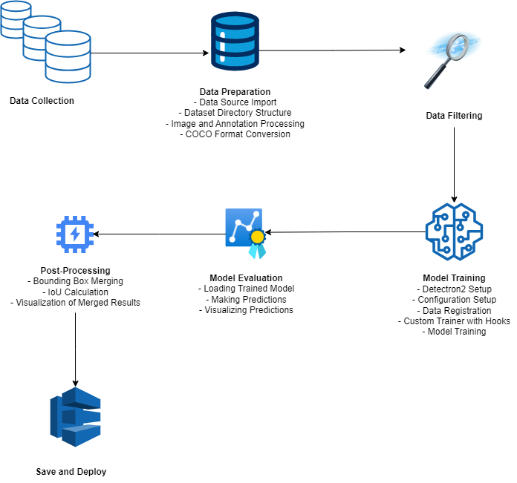
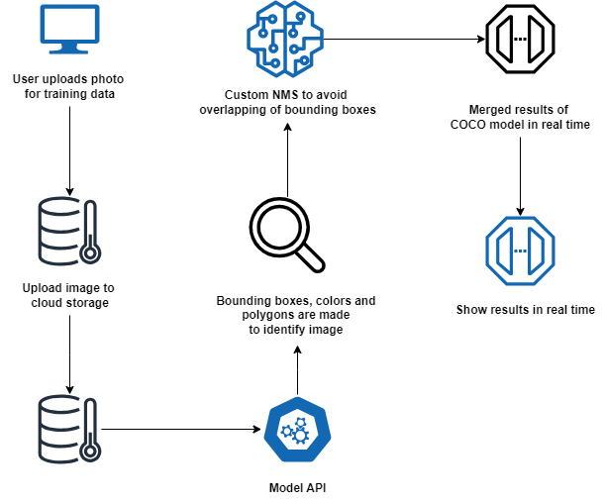
Solution METHODOLOGY
Model Training
Model Deployment

Slide 7
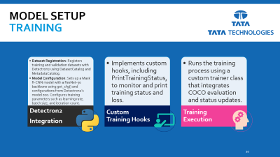
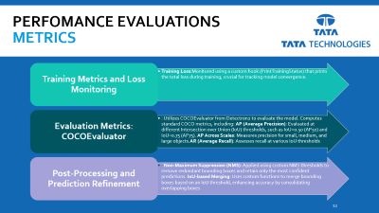
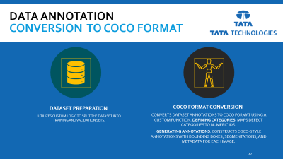
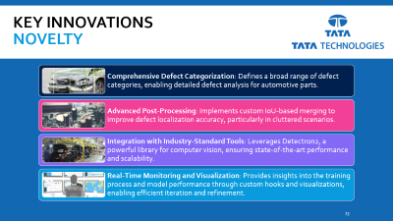
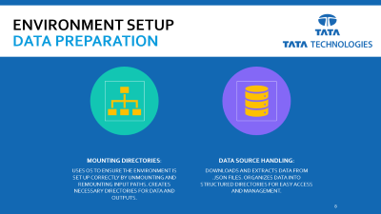
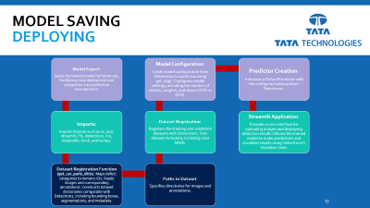






Overview of the
Solution

Slide 8
Environment Setup
Data Preparation
Mounting Directories:
Uses os to ensure the environment is set up correctly by unmounting and remounting input paths. Creates necessary directories for data and outputs.
Data Source Handling:
Downloads and extracts data from .json files. Organizes data into structured directories for easy access and management.

Slide 9


Data Annotation
Conversion to COCO Format
Dataset Preparation:
Utilizes custom logic to split the dataset into training and validation sets.
COCO Format Conversion:
Converts dataset annotations to COCO format using a custom function. Defining Categories: Maps defect categories to numeric IDs.
Generating Annotations: Constructs COCO-style annotations with bounding boxes, segmentations, and metadata for each image.

Slide 10
Model Setup
training
Detectron2
Integration
Custom Training Hooks
Training Execution
Dataset Registration: Registers training and validation datasets with Detectron2 using DatasetCatalog and MetadataCatalog.
Model Configuration: Sets up a Mask R-CNN model with a ResNet-50 backbone using get_cfg() and configurations from Detectron2's model zoo. Configures training parameters such as learning rate, batch size, and iteration count.
Implements custom hooks, including PrintTrainingStatus, to monitor and print training status and loss.
Runs the training process using a custom trainer class that integrates COCO evaluation and status updates.

Slide 11
PERFOMANCE EVALUATIONS
METRICS
Training Metrics and Loss Monitoring
Evaluation Metrics: COCOEvaluator
Post-Processing and Prediction Refinement
Training Loss:Monitored using a custom hook (PrintTrainingStatus) that prints the total loss during training, crucial for tracking model convergence.
: Utilizes COCOEvaluator from Detectron2 to evaluate the model. Computes standard COCO metrics, including: AP (Average Precision): Evaluated at different Intersection over Union (IoU) thresholds, such as IoU=0.50 (AP50) and IoU=0.75 (AP75). AP Across Scales: Measures precision for small, medium, and large objects.AR (Average Recall): Assesses recall at various IoU thresholds
: Non-Maximum Suppression (NMS): Applied using custom NMS thresholds to remove redundant bounding boxes and retain only the most confident predictions. IoU-based Merging: Uses custom functions to merge bounding boxes based on an IoU threshold, enhancing accuracy by consolidating overlapping boxes

Slide 12
Model saving
deploying
Model Export:
Saves the trained model for future use, facilitating easy deployment and integration into production environments.
Imports:
Imports libraries such as os, json, streamlit, PIL, detectron2, cv2, matplotlib, torch, and numpy.
Dataset Registration Function (get_car_parts_dicts): Maps defect categories to numeric IDs. Reads images and corresponding annotations. Constructs dataset dictionaries compatible with Detectron2, including bounding boxes, segmentations, and metadata.
Paths to Dataset:
Specifies directories for images and annotations.
Dataset Registration:
Registers the training and validation datasets with Detectron2. Sets dataset metadata, including class labels.
Model Configuration:
Loads model configuration from Detectron2's model zoo using get_cfg(). Configures model settings, including the number of classes, weights, and device (CPU or GPU).
Predictor Creation:
Initializes a DefaultPredictor with the configured settings from Detectron2.
Streamlit Application:
Provides a user interface for uploading images and displaying detection results.Utilizes the trained model to make predictions and visualizes results using Detectron2’s Visualizer class.

Slide 13
KEY innovations
novelty
Comprehensive Defect Categorization: Defines a broad range of defect categories, enabling detailed defect analysis for automotive parts.
Advanced Post-Processing: Implements custom IoU-based merging to improve defect localization accuracy, particularly in cluttered scenarios.
Integration with Industry-Standard Tools: Leverages Detectron2, a powerful library for computer vision, ensuring state-of-the-art performance and scalability.
Real-Time Monitoring and Visualization: Provides insights into the training process and model performance through custom hooks and visualizations, enabling efficient iteration and refinement.

Slide 14
how were
Challenges overcome?
Limited Data Access: Limited high-quality, well-annotated datasets for training. Solution: Data Augmentation
Bounding Box Merging: Handling overlapping bounding boxes in detection results. Solution: Non-Maximum Suppression
Achieving optimal model efficiency: Balancing different hyperparameters to maximize Intersection Over Union area. Instilling IOU threshold

Slide 15






Aspects of Technical implementation
Programming Languages:
Python 3.10: Primary language used for coding and implementing machine learning models.
Libraries and Frameworks:
Detectron2: A powerful library developed by Facebook AI Research for object detection and segmentation.
ResNet: Utilized as a backbone for our object detection model to enhance feature extraction.
OpenCV: Used for image processing tasks.
PIL (Python Imaging Library): Used for image manipulation and preprocessing.
shapely: For handling and manipulating geometric objects.
Data Handling and Preparation:
json: To handle annotation files and other data formats.
shutil: For file operations such as copying and moving files.
Visualizations :
matplotlib: For visualizaing images and annotations
Environment:
Kaggle Notebooks: Used for development and running experiments due to its readily available compute resources and GPU support.
Model Training and Evaluation :
Detectron2 DefaultTrainer: Utilized for training the model with custom configurations.
PyTorch: The deep learning framework underlying Detectron2
CUDA: To leverage GPU acceleration for faster model training..
detectron2.utils.visualizer: To visualize model predictions and dataset annotations

Slide 16
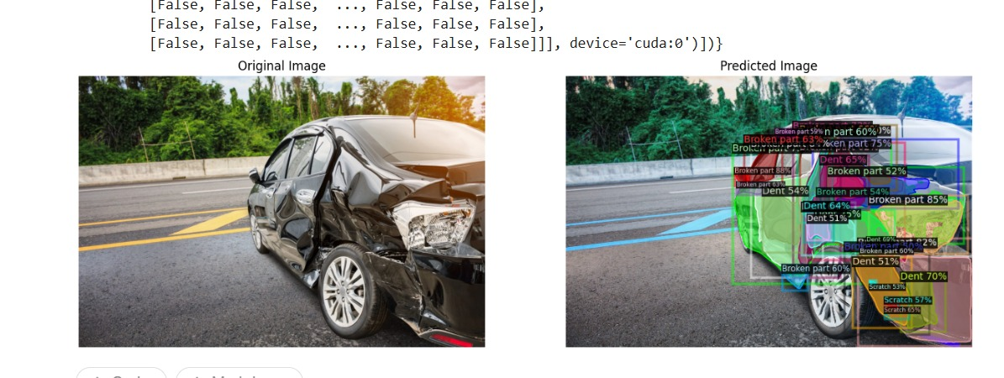
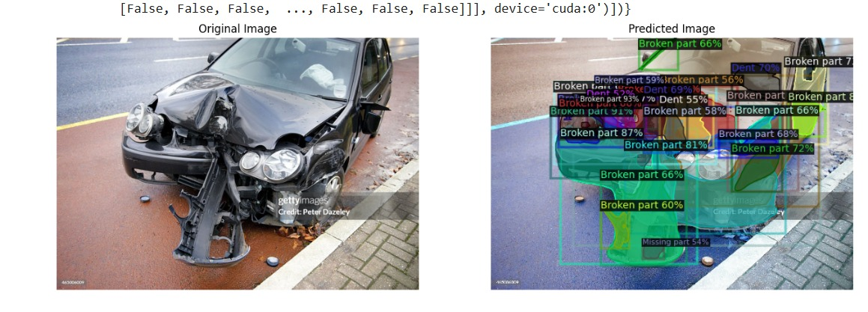
Showcase of Results
An optimal model has been successfully developed using cutting-edge technologies to detect defects in the automobile industry during production. This model utilizes bounding boxes and spatial polygons and features a user-friendly interface.
To see how these outputs were generated please click on https://drive.google.com/drive/folders/14ruH8P7tgNMVDTzXRBFwkHT1m0EDlHup?usp=sharing

Slide 17
recorded demonstration
To see how our recorded demonstration of our digital prototype please click on the link below https://drive.google.com/drive/folders/14ruH8P7tgNMVDTzXRBFwkHT1m0EDlHup?usp=sharing

Slide 18
potential future Enhancements
Month 1: Expanding and Improving the Dataset
Expand dataset with high-risk vehicle parts.
Enhance model to detect and localize defects.
Address data quality, resource optimization, and model refinement.
Month 2: Developing a User-Centric App
Develop user-friendly application.
Implement real-time testing.
Integrate 3D visualization features.
Month 3: Enhancing Features and Testing
Integrate new app features.
Conduct comprehensive scenario testing.
Assess defect intensity and depth.

Slide 19
POC development project plan
Laying the Foundation
Dataset Preparation: Converted datasets to COCO format for Detectron2 compatibility.
Framework Integration: Established development environment with PyTorch and Detectron2 for efficient model training.
Training and Validation
Model Training:
Infrastructure: Leveraged Detectron2’s DefaultTrainer for automated logging, checkpointing, and evaluation.
Custom Hooks: Implemented hooks for real-time monitoring and debugging.
Data Validation: Conducted visual inspections and adjusted configurations to ensure optimal performance.
Prediction and Fine-Tuning
Inference:
Execution: Used DefaultPredictor and Visualizer for generating and visualizing predictions.
Accuracy Enhancement: Applied Non-Maximum Suppression (NMS) to minimize redundant detections and improve localization precision.

Slide 20
THANK YOU!
TEAM NAME:
S3RK

